Slide 1


1
Introduction to Computing and Programming
C# Programming: From Problem Analysis to Program Design

Slide 2
Chapter Objectives
Learn about the history of computers
Explore the physical components of a computer system
Examine how computers represent data
Learn to differentiate between system and application software

Slide 3
Chapter Objectives (continued)
Learn the steps of software development
Explore different programming methodologies
Become aware of how C# and .NET evolved and fit together
Learn why C# is being used today for software development

Slide 4
History of Computers
Computing dates back 5,000 years
Currently in fourth or fifth generation of modern computing
Pre-modern computing
Abacus
Pascaline (1642)
Analytical Engine (1830 – Charles Babbage & Lady Lovelace)

Slide 5

History of Computers (continued)
Figure 1-1 The abacus, the earliest computing device

Slide 6
History of Computers (continued)
First generation distinguished by use of vacuum tubes (mid 1940s)
Second generation distinguished by use of transistors (mid 1950s)
Software industry born (COBOL, Fortran)
Third generation – transistors squeezed onto small silicon discs (1964-1971)
Computers became smaller
Operating systems first seen

Slide 7
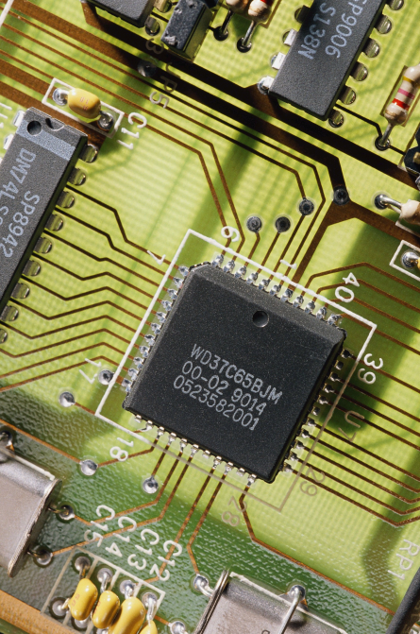
History of Computers (continued)
Figure 1-2 Intel chip

Slide 8
History of Computers (continued)
Fourth generation – computer manufacturers brought computing to general consumers
Introduction of IBM personal computer (PC) and clones (1981)
Fifth generation – more difficult to define
Computers accept spoken word instructions
Computers imitate human reasoning through AI
Computers communicate globally
Mobile and wireless applications are growing

Slide 9
Physical Components of a Computer System
Hardware
Physical devices that you can touch
Central processing unit (CPU)
Brain of the computer
Housed inside system unit on silicon chip
Most expensive component
Performs arithmetic and logical comparisons on data and coordinates the operations of the system

Slide 10
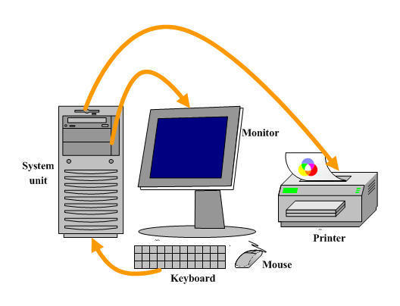
Physical Components of a Computer System (continued)
Figure 1-3 Major hardware components

Slide 11
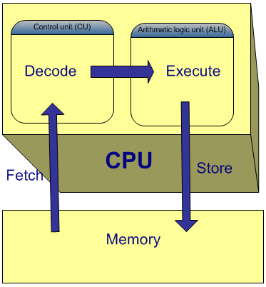
Physical Components of a Computer System (continued)
Figure 1-4 CPU’s instruction cycle

Slide 12
Physical Components of a Computer System (continued)
Primary storage – main memory
Called random-access memory (RAM)
Cache
Type of random access memory that can be accessed more quickly than regular RAM
Acts like a buffer, or temporary storage location
Two forms of cache memory: L1 and L2
Each cell has a unique address

Slide 13
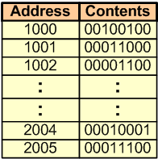
Physical Components of a Computer System (continued)
Figure 1-5 Addressing in memory

Slide 14
Physical Components of a Computer System (continued)
Auxiliary storage – secondary storage
Nonvolatile, permanent memory
Most common types are magnetic and optic disks (hard disk, CD, DVD, zip, and flash memory)
Input/Output Devices
Used to get data inside the machine
Drive is the device used to store/retrieve from several types of storage media

Slide 15
Data Representation
Bits
Bit – "Binary digIT"
Binary digit can hold 0 or 1
1 and 0 correspond to on and off, respectively
Bytes
Combination of 8 bits
Represent one character, such as the letter A
To represent data, computers use the base-2 number system, or binary number system

Slide 16
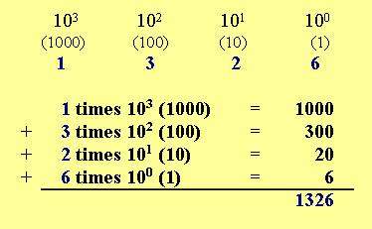
Binary Number System
Figure 1-6 Base–10 positional notation of 1326

Slide 17
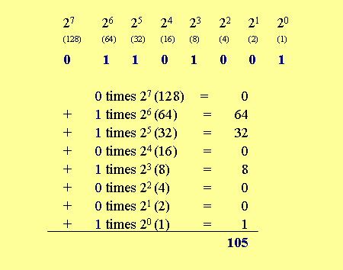
Binary Number System (continued)
Figure 1-7 Decimal equivalent of 01101001

Slide 18
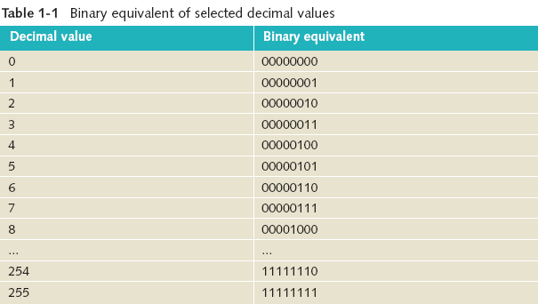

Data Representation (continued)

Slide 19
Data Representation (continued)
Character sets
With only 8 bits, can represent 2⁸, or 256, different decimal values ranging from 0 to 255; this is 256 different characters
Unicode – Character set used by C# (pronounced C Sharp)
Uses 16 bits to represent characters
2¹⁶, or 65,536 unique characters, can be represented
American Standard Code for Information Interchange (ASCII) – subset of Unicode
First 128 characters are the same

Slide 20
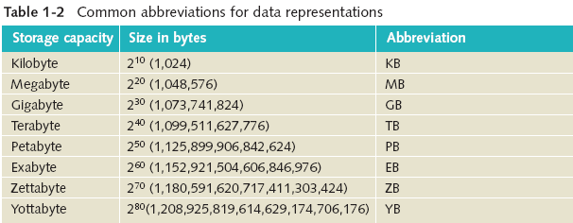
Data Representation (continued)

Slide 21
Software
Consists of programs
Sets of instructions telling the computer exactly what to do
Two types of software
System
Application
Power of what the computer does lies with what types of software are available

Slide 22
System Software
System software is more than operating systems
Operating System
Loaded when you power on the computer
Examples include Windows XP, Windows NT, UNIX, and DOS
Includes file system utilities, communication software
Includes compilers, interpreters, and assemblers

Slide 23
Application Software
Application software performs a specific task
Word processors, spreadsheets, payroll, inventory
Writes instructions using a high-level programming language
C#, Java, Visual Basic
Compiler
Translates instructions into machine-readable form
First checks for rule violations
Syntax rules – how to write statements

Slide 24
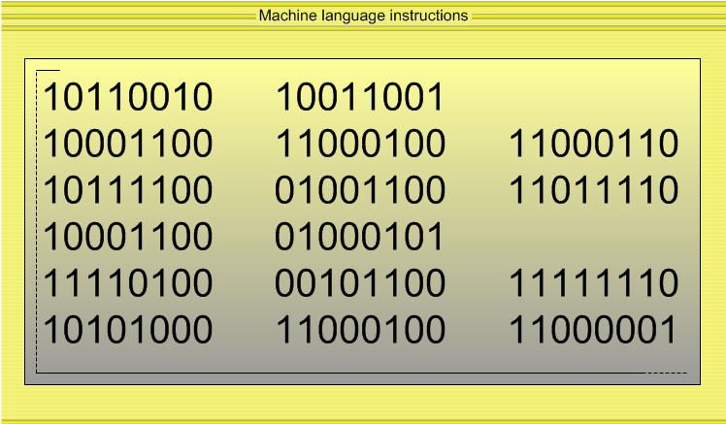
Software (continued)
Figure 1-8 A machine language instruction

Slide 25
Software Development Process
Programming is a process of problem solving
How do you start?
Number of different approaches, or methodologies
Successful problem solvers follow a methodical approach

Slide 26
Steps in the Program Development Process
1. Analyze the problem
2. Design a solution
3. Code the solution
4. Implement the code
5. Test and debug
6. Use an iterative approach

Slide 27
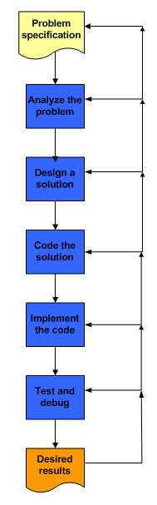
Steps in the Program Development Process
Software development process is iterative
As errors are discovered, it is often necessary to cycle back to a previous phase or step
Figure 1-13 Steps in the software
development process

Slide 28
Step 1: Analyze the Problem
Precisely what is software supposed to accomplish?
Understand the problem definition
Review the problem specifications

Slide 29
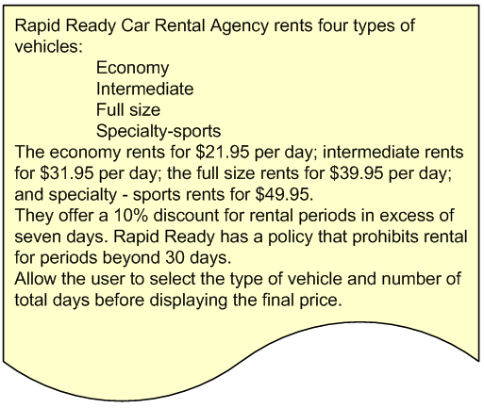
Analyze the Problem (continued)
Figure 1-9 Program specification sheet for a car rental agency problem

Slide 30
Analyze the Problem (continued)
What kind of data will be available for input?
What types of values (i.e., whole numbers, alphabetic characters, and numbers with decimal points) will be in each of the identified data items?
What is the domain (range of the values) for each input item?
Will the user of the program be inputting values?
If the problem solution is to be used with multiple data sets, are there any data items that stay the same, or remain constant, with each set?

Slide 31
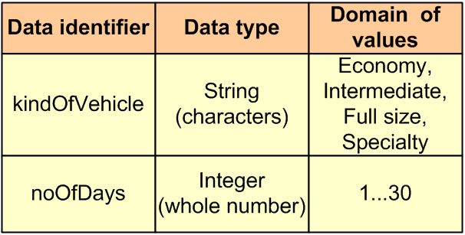
Analyze the Problem (continued)
May help to see sample input for each data item
Figure 1-10 Data for car rental agency

Slide 32
Step 2: Design a Solution
Several approaches
Procedural and object-oriented methodologies
Careful design always leads to better solutions
Divide and Conquer
Break the problem into smaller subtasks
Top-down design, stepwise refinement
Algorithms for the behaviors (object-oriented) or processes (procedural) should be developed

Slide 33
Design a Solution (continued)
Algorithm
Clear, unambiguous, step-by-step process for solving a problem
Steps must be expressed so completely and so precisely that all details are included
Instructions should be simple to perform
Instructions should be carried out in a finite amount of time
Following the steps blindly should result in the same results

Slide 34
Design
Object-oriented approach
Class diagram
Divided into three sections
Top portion identifies the name of the class
Middle portion lists the data characteristics
Bottom portion shows what actions are to be performed on the data

Slide 35
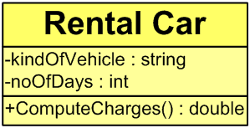
Class Diagram
Figure 1-11 Class diagram of car rental agency

Slide 36
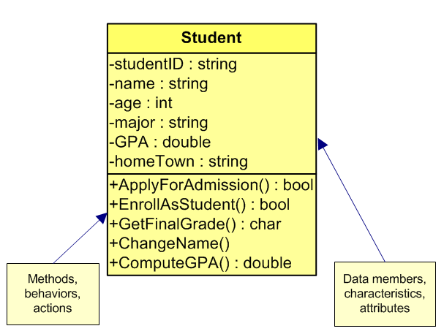
Class Diagram (continued)
Figure 1-15 Student class diagram

Slide 37
Design (continued)
Structured procedural approach
Process oriented
Focuses on the processes that data undergoes from input until meaningful output is produced
Tools used
Flowcharts
Pseudocode, structured English
Algorithm written in near English statements for pseudocode

Slide 38
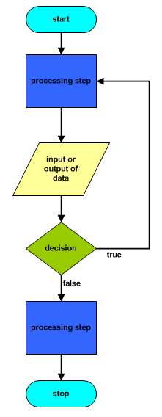
Flowchart
Oval – beginning and end
Rectangular – processes
Diamond – decision to be made
Parallelogram – inputs and output
Flow line
Figure 1-14 Flowchart symbols
and their interpretation

Slide 39
Step 3: Code the Solution
After completing the design, verify the algorithm is correct
Translate the algorithm into source code
Follow the rules of the language
Integrated Development Environment (IDE)
Visual Studio
Tools for typing program statements, compiling, executing, and debugging applications

Slide 40
Step 4: Implement the Code
Source code is compiled to check for rule violations
C# → Source code is converted into Microsoft Intermediate Language (IL)
IL is between high-level source code and native code
IL code not directly executable on any computer
IL code not tied to any specific CPU platform
Second step, managed by .NET’s Common Language Runtime (CLR), is required

Slide 41
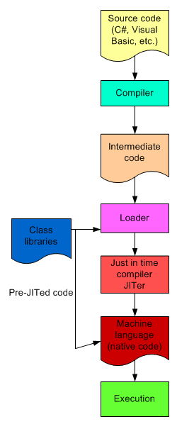
Implement the Code (continued)
CLR loads .NET classes
A second compilation, called a just-in-time (JIT) compilation is performed
IL code is converted to the platform’s native code
Figure 1-12
Execution steps for .NET

Slide 42
Step 5: Test and Debug
Test the program to ensure consistent results
Test Driven Development (TDD)
Development methodologies built around testing
Plan your testing
Test plan should include extreme values and possible problem cases
Logic errors
Might cause abnormal termination or incorrect results to be produced
Run-time error is one form of logic error

Slide 43
Programming Methodologies
Structured Procedural Programming
Emerged in the 1970s
Associated with top-down design
Analogy of building a house
Write each of the subprograms as separate functions or methods invoked by a main controlling function or module
Drawbacks
During software maintenance, programs are more difficult to maintain
Less opportunity to reuse code

Slide 44
Programming Methodologies (continued)
Object-oriented
Newer approach
Construct complex systems that model real-world entities
Facilitates designing components
Assumption is that the world contains a number of entities that can be identified and described

Slide 45
Object-Oriented Methodologies
Abstraction
Through abstracting, determine attributes (data) and behaviors (processes on the data) of the entities
Encapsulation
Combine attributes and behaviors to form a class
Polymorphism
Methods of parent and subclasses can have the same name, but offer different functionality
Invoke methods of the same name on objects of different classes and have the correct method executed

Slide 46
The Evolution of C# and .NET
1940s: Programmers toggled switches on the front of computers
1950s: Assembly languages replaced the binary notation
Late 1950s: High-level languages came into existence
Today: More than 2,000 high-level languages
Noteworthy high-level programming languages are C, C++, Visual Basic, Java, and C#

Slide 47
C#
One of the newest programming languages
Conforms closely to C and C++
Has the rapid graphical user interface (GUI) features of previous versions of Visual Basic
Has the added power of C++
Has the object-oriented class libraries similar to Java

Slide 48
C# (continued)
Can be used to develop a number of applications
Software components
Mobile applications
Dynamic Web pages
Database access components
Windows desktop applications
Web services
Console-based applications

Slide 49
.NET
Not an operating system
An environment in which programs run
Resides at a layer between operating system and other applications
Offers multilanguage independence
One application can be written in more than one language
Includes over 2,500 reusable types (classes)
Enables creation of dynamic Web pages and Web services
Scalable component development

Slide 50
C# Relationship to .NET
Many compilers targeting the .NET platform are available
C# was used most heavily for development of the .NET Framework class libraries
C#, in conjunction with the .NET Framework classes, offers an exciting vehicle to incorporate and use emerging Web standards

Slide 51
C# Relationship to .NET (continued)
C# is object-oriented
In 2001, the European Computer Manufacturers Association (ECMA) General Assembly ratified C# and its common language infrastructure (CLI) specifications into international standards

Slide 52
Visual Studio 2005
Launched November 2005
Included new language features (C# 2.0)
i.e. partial classes, generics,
Added enhancements to the IDE
i.e. refactoring, code snippets
Less than 6 months after the release, specifications for C# 3.0 and the next version of Visual Studio (code named Orcas) were unveiled [May 2006]

Slide 53
Chapter Summary
Computing dates back some 5,000 years
Currently in 4th or 5th generation of computing
Physical components of the computer
System software versus application software
Steps in program development process
1. Analyze the problem
2. Design a solution
3. Code the solution
4. Implement the code
5. Test and debug

Slide 54
Chapter Summary (continued)
Programming methodologies
Structured procedural
Object-oriented
C#
One of the .NET managed programming languages
Object-oriented
2001 EMCA standardized
Provides rapid GUI development of Visual Basic
Provides number crunching power of C++
Provides large library of classes similar to Java

